Slide 1
AI-POWERED COLLECTIONS STRATEGY
LEVERAGING AGENTIC AI FOR SCALABLE, FAIR, AND EFFECTIVE DEBT MANAGEMENT AT GELDIUM
2025 November 3
Shivam Bansal

Slide 2
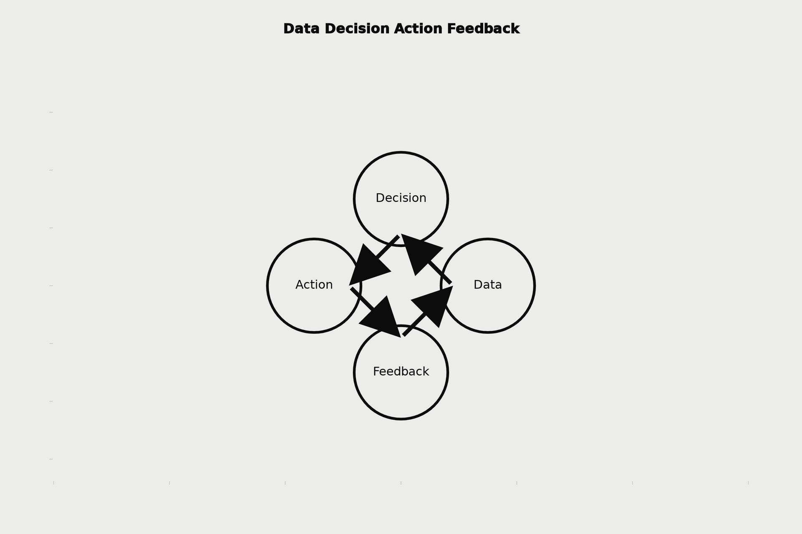
HOW THE SYSTEM WORKS (OVERVIEW)
1. Data Input:
  Customer transaction history, repayment patterns, demographics, communication logs, credit behavior
  External credit scores and macroeconomic indicators
2. Predictive Decision Logic:
  Machine Learning model predicts delinquency probability
  Segments customers by risk tiers: Low, Medium, High
  Triggers tailored collection strategies
3. Automated Actions:
  Personalized messages, reminders, and restructuring offers
  Dynamic communication through preferred customer channels
  Escalation to human agents for complex or sensitive cases
4. Learning Loop:
  System tracks outcomes → feedback used to retrain model
  Improves accuracy, fairness, and effectiveness over time

Slide 3
ROLE OF AGENTIC AI
Autonomous (AI-led)
Human Oversight (Analyst/Agent-led)
  Predicting default likelihood
  Sending personalized reminders
  Scheduling follow-up actions
  Updating risk tiers dynamically
  Monitoring repayment trends
Approving or modifying repayment plans
Handling escalated or disputed cases
Reviewing flagged edge cases
Ensuring compliance and fairness
Continuous supervision and audit

Slide 4

RESPONSIBLE AI GUARDRAILS
Fairness & Bias Mitigation
Regulatory Alignment
Adheres to financial conduct regulations (e.g., RBI, GDPR-like data privacy)
Maintains full audit trail of data usage and decisions
Regular audits to detect demographic or behavioral bias
Use of explainable models (e.g., SHAP/LIME) for interpretability
Explainability & Transparency
Human-in-the-Loop Governance
Every decision traceable — “why this action was taken” view for compliance teams
AI suggestions validated by human agents for sensitive outcomes

Slide 5
EXPECTED BUSINESS IMPACT
Quantitative (Business KPIs)
Qualitative (Customer & Brand Outcomes)
  15–25% reduction in delinquency rates through early prediction
  20–30% lower collection costs via automation
  Faster resolution time with real-time insights
  Higher recovery rates for mid-risk customers
  Improved customer experience through empathetic and personalized communication
  Enhanced fairness and trust in the debt recovery process
  Stronger compliance reputation with regulators
  Scalable, future-ready system adaptable to evolving data

Slide 6
“AN AI SYSTEM THAT DOESN’T JUST COLLECT — IT CONNECTS.”
By blending automation, compliance and empathy, Geldium’s AI collections system ensures financial responsibility, customer dignity and operational efficiency.

